Slide 1
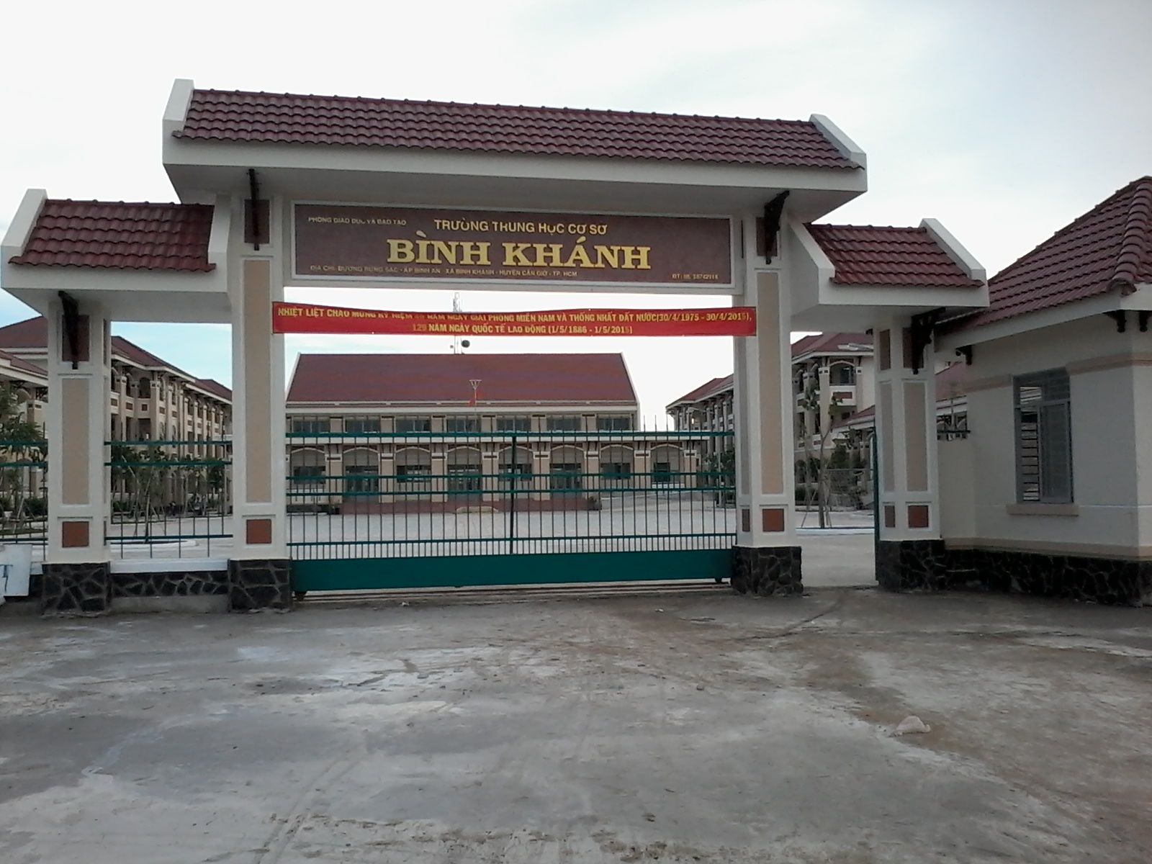



BINH KHANH SECONDARY SCHOOL
FRIENDS PLUS 6

Slide 2

Crosswords

Slide 3

L
U
C
K
Y
M
O
N
E
Y
A
O
D
A
I
F
I
R
E
W
O
R
K
H
O
M
E
W
O
R
K
R
E
S
T
A
U
R
A
N
T
1) This is a thing Vietnamese people often give to children with New Year’s wishes.
3) Look at picture and answer: “What is it?”
5) This is a place where people can eat and drink.
2) The tradition dress of Vietnamese women.
Fill in the blank:
Students have to finish their ______ before going to school.

Slide 4
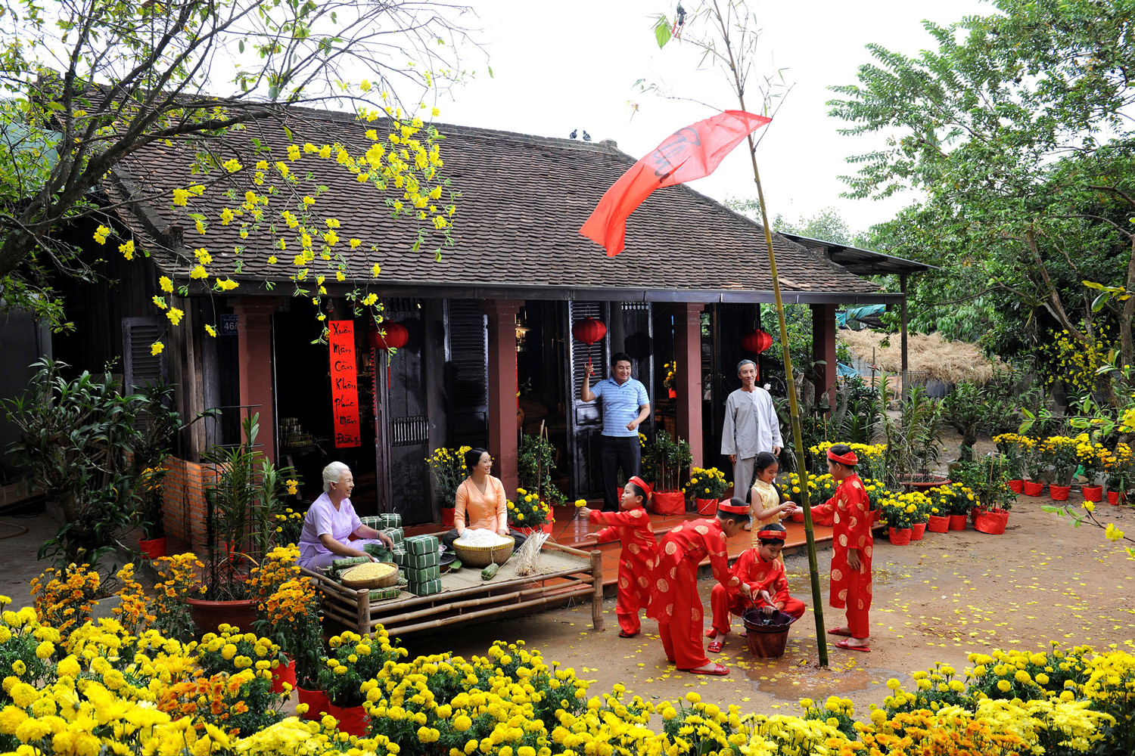
The most important festival in Viet Nam.
I
L
Y
A
D
E
H
T
T
O

Slide 5

UNIT 2: days
Lesson 5: language focus

Slide 6

Match questions 1–5 with answers a–e
What presents do you prefer? | a) No, I don’t
2) Where do you eat? | b) I prefer lucky money
3) Who does she invite? | c) At my grandmother’s house
4) Does the lion stop at all of the restaurants? | d) Yes, it does
5) Do you like fireworks? | e) All the family

Slide 7
PRESENT SIMPLE TENSE (cont)
QUESTIONS
YES-NO QUESTIONS
WH-QUESTIONS

Slide 8
☞ Yes-no Questions
TOBE:
Am/ Is/ Are + S + O ?
Short answer:
Yes, S + am/ is / are.
No, S + am/ is /are + NOT.
Ex: Are you a student?
Yes, I am. / No, I’m not.

Slide 9
b) Ordinary Verbs:
Do / Does + S + V + O?
Short answer:
Yes, S + do/ does.
No, S + do/ does + NOT.
Ex: Do you like this celebration?
Yes, I do. / No, I don’t.

Slide 10
WH-QUESTIONS
TOBE:
Wh- question word + am/ is/ are + S ?
Ex: Where are you from?
Who is he?
b) Ordinary Verbs:
Wh- question word + do / does + S + V_{inf} + O?
Ex: Where do you come from?
What does she do?

Slide 11

1) We use
do and does
/ is and are
when we make
present simple questions with regular verbs.
2) We
add /
don’t add
-s to the he, she and it forms of
regular verbs in questions.
3) We put question words (Where, What, Who, When, etc.) at the
beginning
/ end
of the question.
4) We use forms of
be /
do
in short answers with regular
verbs.

Slide 12
Choose the correct words
1) Do / Does you get up at 6 a.m.?
2) Who are / do you see at the weekend?
3 ) Does / Do your dad watch TV in the evening?
4 ) What do you has / have for breakfast on weekdays?
5 ) Where is / does your family go in the holidays?

Slide 13
Complete the Key Phrases
Time expressions
1) ______ the holidays / the summer / the evening / …
2) ________ 6 a.m. / 2.30 p.m. / …
3) ________ weekdays / Monday / Tuesday …
4) ________ the weekend, New Year …
IN
AT
ON
AT

Slide 14
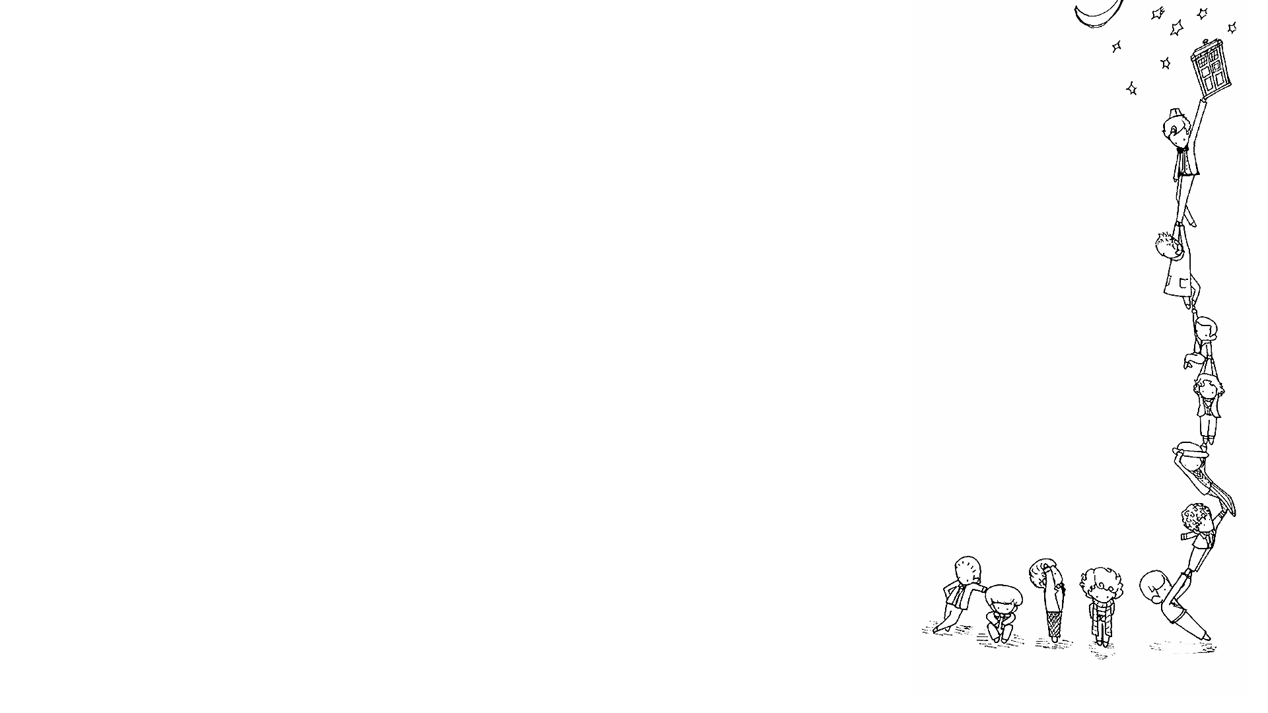
5 p.m, 12 o’clock,….
AT
breakfast, lunch,….
night, Christmas, weekend,….
ON
Sunday, Sunday morning, Christmas Day….
22nd September 2020, ….
(the) weekend, holiday, ….
October, 2012, …
IN
the summer / winter / ….
3 minutes, 2 weeks, ….

Slide 15

Pair-work

Slide 16
Write questions with words from the grid
CELEBRATE | GO TO BED | LIVE
LIKE | YOU | DO
WHERE | YOUR PARENTS | HELP AT HOME
YOUR BEST FRIEND | WHEN | YOUR TEACHER
DOES | COOKING | HOW OFTEN

Slide 17
Choose and tick (✓) the simple sentences
1. I prefer lucky money. _____
2. I like reading, but she likes chatting online. _____
3. She loves oranges but hates apples. _____
4. She and I eat apples. _____
5. She plays football, and he likes it. _____
√
√

Slide 18

Work in pairs. Complete questions 1–7 with time expressions from the Key Phrases. Ask and answer the questions.
1) What … do … ?
2) Who … go out with … ?
3) What time … get up / go to bed … ?
4) What TV programmes … your dad watch … ?
5) When … do your homework … ?
6) How … your mum relax … ?
7) Where … go … ?

Slide 19


Slide 20

Write six questions for an interview with your favourite celebrity. Then act out your interview with a partner.

Slide 21

Homework
- Learn by heart all structures.
- Write a short paragraph about what you do in a day.

